Slide 1
Arbitective
Presented by - Dhruv and Ardeshir (Adi)
Notes:
Dhruv

Slide 2
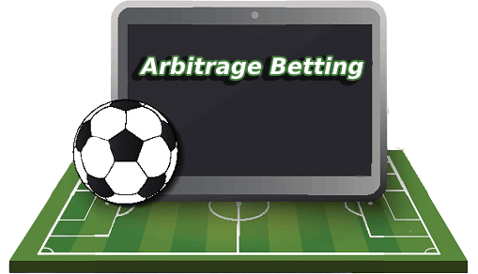
Table of Content
What is Arbitrage Betting?
Calculating Arbitrage
Usage
Data Acquisition
Machine learning
Libraries Used
Prototype FrontEnd (Arbitective)
Notes:
dhruv

Slide 3

What is Arbitrage Betting ?
TEAM A v/s TEAM B
Bookmaker 1:
Team A Wins: 2.10 - Draw: 3.50 - Team B Wins: 4.00
Bookmaker 2:
Team A Wins: 1.90 - Draw: 3.25 - Team B Wins: 4.50
Notes:
dhruv

Slide 4

Calculating Arbitrage
Identify the Best Odds:
For Team A: Take the higher odds from Bookmaker 1 (2.10)
For Draw: Take the higher odds from Bookmaker 1 (3.50)
For Team B: Take the higher odds from Bookmaker 2 (4.50)
Calculate Implied Probability:
Team A: 1 / 2.10 = 0.4762 (47.62%)
Draw: 1 / 3.50 = 0.2857 (28.57%)
Team B: 1 / 4.50 = 0.2222 (22.22%)
Total Implied Probability: 0.4762 + 0.2857 + 0.2222 = 0.9841 (98.41%)
Determine the Arbitrage: Since the total is less than 100%, an arbitrage opportunity exists.
01
02
03

Slide 5



Usage
Detect arbitrage betting opportunities based on odds of multiple bookmakers.
Aid Bookmakers to limit windows of opportunity to avoid financial losses.
Security - Only accessible by clients to ensure the front end is not used unethically.
Notes:
drhuv

Slide 6

Data Acquisition
01
English Premier League
02
Odd-api : Historical Odds of all bookmakers for a given match/fixture.
03
Used AI to multiply/enhance data to aid machine learning model and avoid API costs.
Notes:
adi

Slide 7
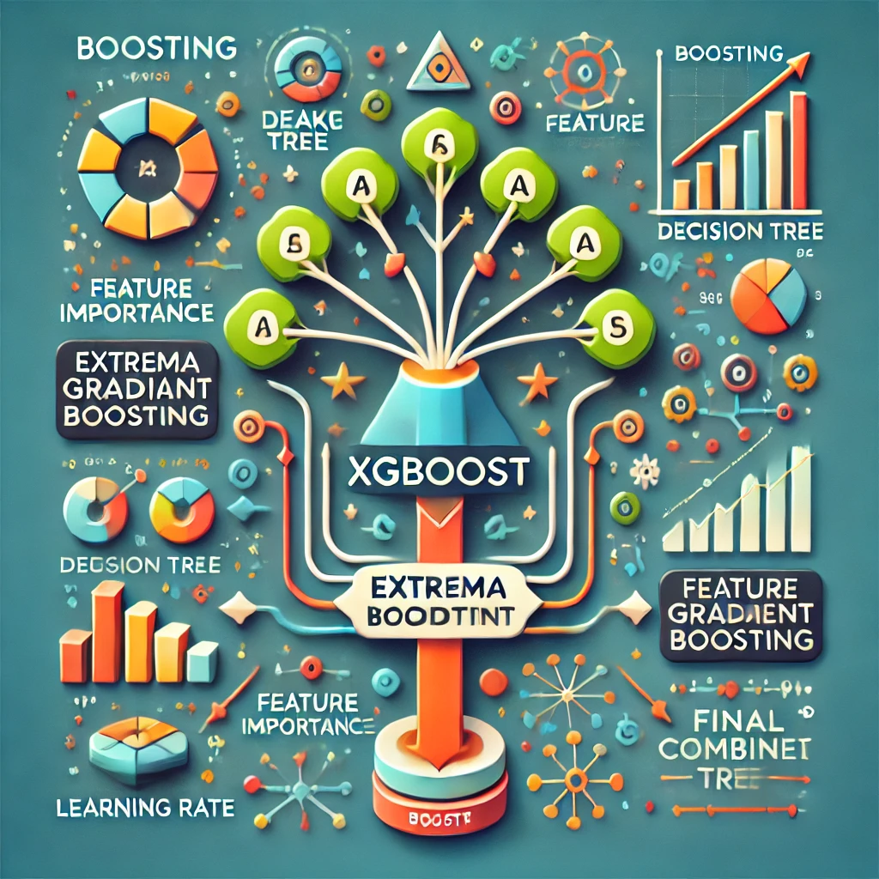
Machine Learning
01
Feature Engineering to calculate Total Implied probability.
02
Used Arbitrage betting logic to create label
03
XGBOOST
Notes:
adi

Slide 8

Libraries Used
Pandas
Matplotlib
Plotly
Steamlit
Scikit Learn
XGBoost
Notes:
adi

Slide 9
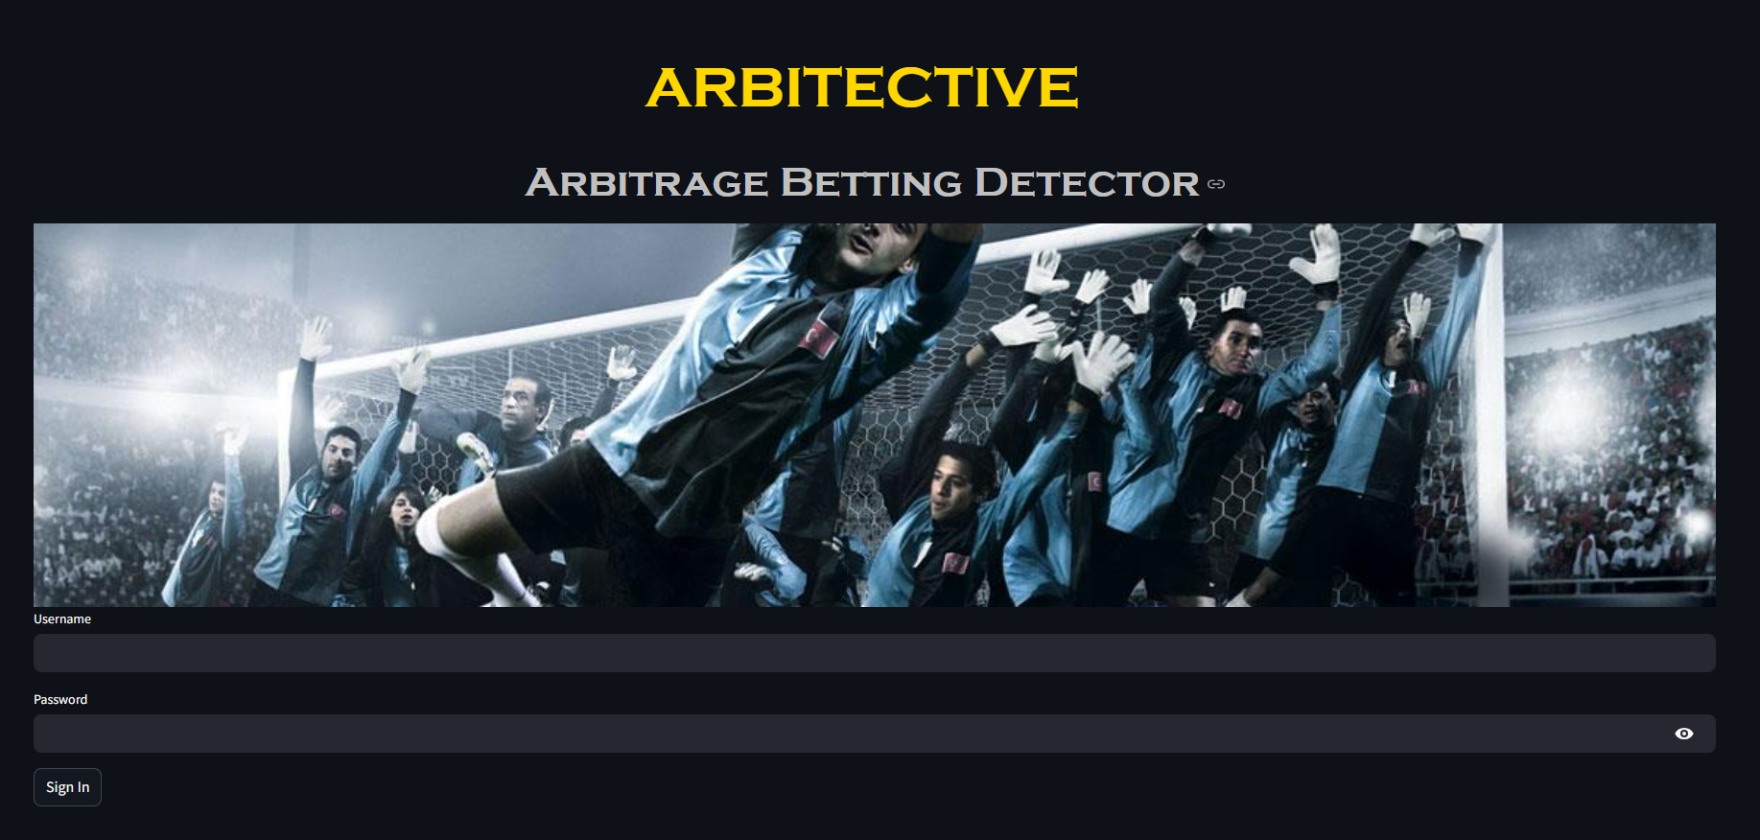
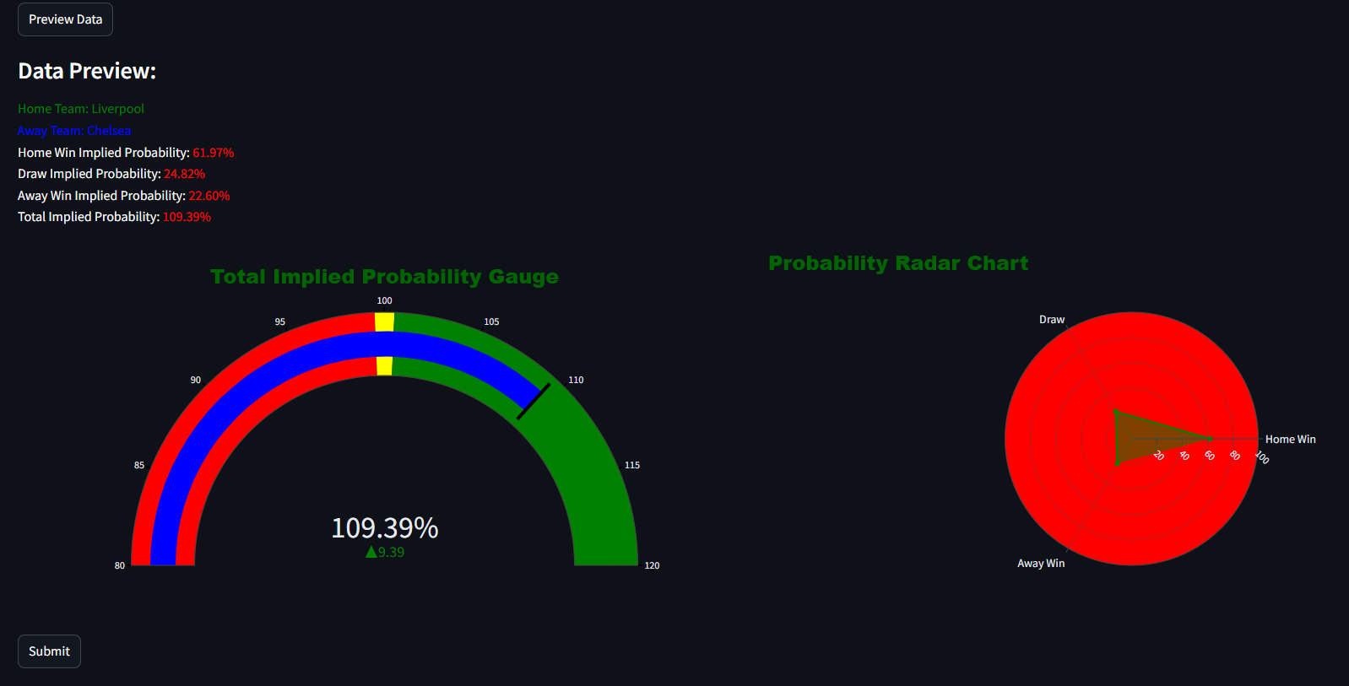
Prototype FrontEnd - Arbitective
https://arbitective.streamlit.app/
Notes:
adi

Slide 10

It was a pleasure learning with you all and we wish you all a successful future. And a special Thanks to Arooj, Mohammed and Laurel for being the best mentors we could have hoped for.

Slide 11


